Slide 1
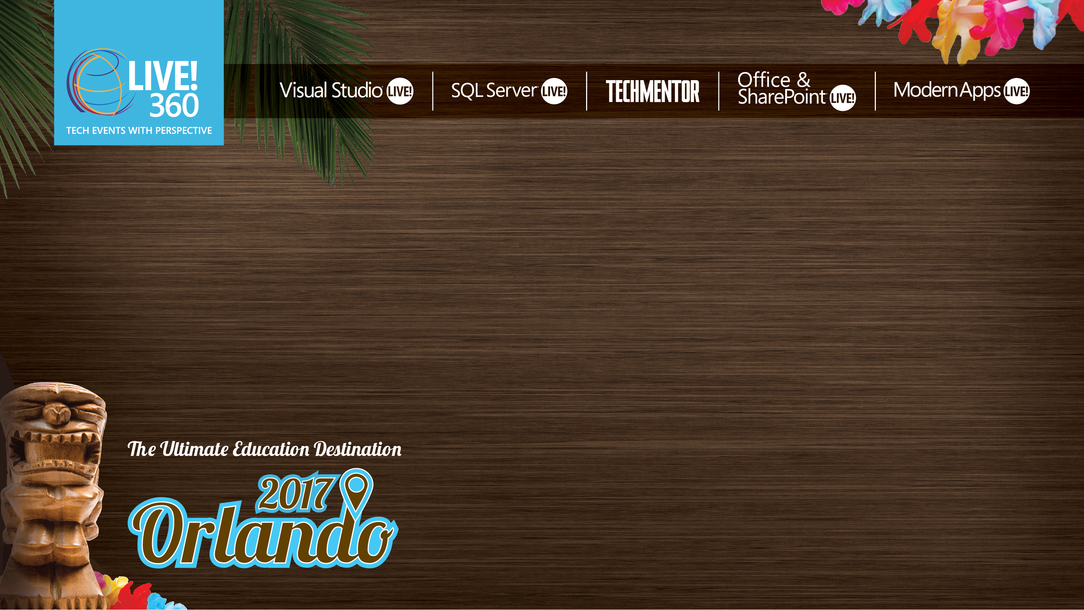
Next Generation UIs
Kevin Ford
Mobile Practice Lead,
Magenic
Level: Intermediate

Slide 2
Presentations and Demos Available At:
https://github.com/Bowman74/MALModernUIDeepDive

Slide 3
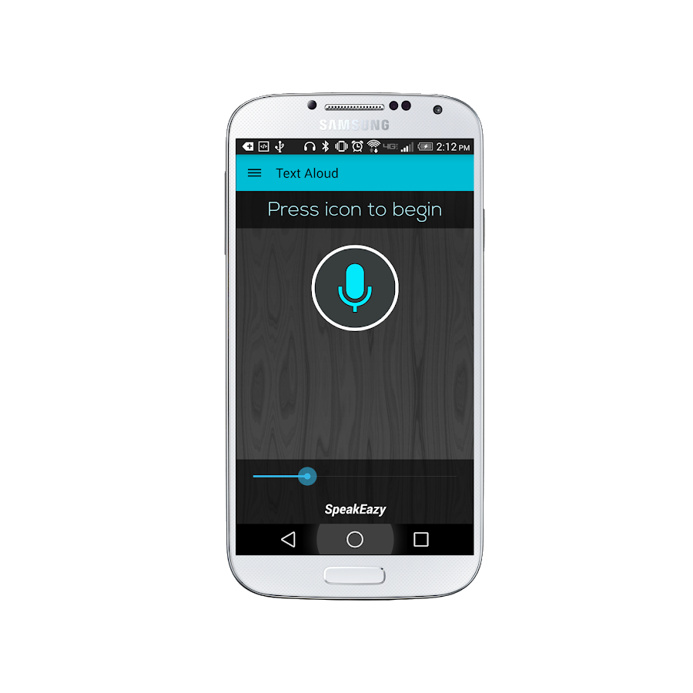
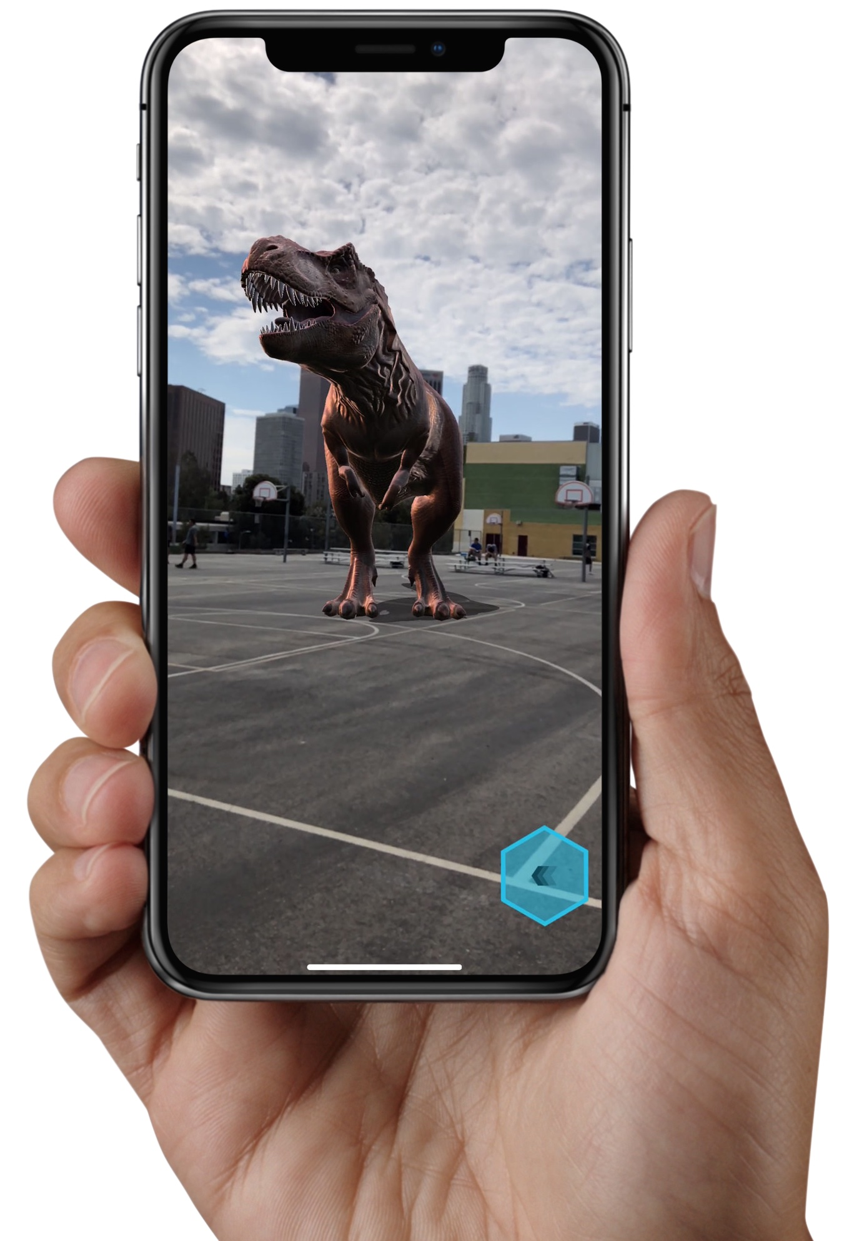
Emerging technologies and patterns to interact with

Slide 4
How AI is enabling this…
New interaction methods require machine understanding
Several Platforms offer these services
AI is now accessible
Don’t require deep AI expertise
Pre-made models

Slide 5
Azure offerings around cognitive services
Bing Entity Search
Speaker Recognition
Computer Vision
Speech
Content Moderator
Language Understanding (LUIS)
Custom Vision
Text Analysis
Face
Translator Text
Notes:
Entity Search –find relative entities (famous people, movies, places) compared to search teams. Allows for categorization
Computer Vision – Understand contents of images. (Handwriting, typed text, celebrities, video analysis)
Content Moderator – Objectional content filter
Custom Vision – Similar to computer vision but can you can train your own models
Face - Face recognition
Speaker Recognition – report who in particular is speaking – authentication
Speech – Recognize what is being said
Language Understanding – understand the INTENT of what is being asked for
Text Analysis - General Purpose understanding what is being typed and what is felt. Even been on a call with a bot and become mad about it…
Translator Text – Translate languages and give alternate explanations to what is being displayed.

Slide 6
Ways to interact with Azure cognitive services
Client APIs
Not available for all platforms
Not always a x-platform design
REST API

Slide 7
Format of the REST API URL
Language Understanding - Custom Service
https://eastus2.api.cognitive.microsoft.com/luis/v2.0/apps/serviceGuid/?subscription-key=serviceKey&timezoneOffset=-360&q={HttpUtility.UrlEncode(requestText)}"
Speech Recognition – Standard Service
https://westus.stt.speech.microsoft.com/speech/recognition/conversation/cognitiveservices/v1?language=en-US&format=simple
Both use POST

Slide 8
Securing standard REST APIs
Using the key directly
request.Headers.Add("Ocp-Apim-Subscription-Key", Url.SpeechKey);
Getting a token
private async Task<string> FetchTokenAsync(string fetchUri, string subscriptionKey)
{
using (var client = new HttpClient())
{
client.DefaultRequestHeaders.Add("Ocp-Apim-Subscription-Key", subscriptionKey);
UriBuilder uriBuilder = new UriBuilder(fetchUri);
var result = await client.PostAsync(uriBuilder.Uri.AbsoluteUri, null);
return await result.Content.ReadAsStringAsync();
}
}
request.Headers.Add("Authorization", $"Bearer {accessToken}");
Token service has to use URL of same data center

Slide 9
Sending parameters to the service
Depends on service type
Language understanding: text on parameter
Image: binary stream - application/octet-stream
Speech recognition: binary stream - audio/wav; codec=audio/pcm; samplerate=16000
May even be able to live stream

Slide 10

LUIS Digging in - Key Concepts
Entity
Intent
App -> Model
Training
Utterance
Role
Notes:
Entity – a list of replaceable elements that tell you something about what is being asked for
Intent – the type of interaction the user wants I want a new project
App – A collection of entities, intents and other items used to create a domain specific model
Training – the process of ensuring that the understanding of the conversation is what you expect
Utterance – input from the user that the app will interpret
Roles – How an entity is being used in an utterance. For example is a city a start location or destination?

Slide 11
LUIS – What’s coming back
{
"query": ”Create a new bug",
"topScoringIntent": {
"intent": ”Create New",
"score": 0.95231
},
"entities": [
{
"entity": "30",
"type": ”ItemType",
"startIndex": 13,
"endIndex": 15,
"resolution": {
"value": ”bug"
}
} ],
"sentimentAnalysis": {
"label": "neutral",
"score": 0.5
}
}

Slide 12
Demo – the LUIS Portal
https://www.luis.ai/applications/

Slide 13
Tying it in with a Bot
Notes:
Web App bot – Bot deployed in PAAS Web App service
Bot channels registration – use when you want to host a bot wherever.
Functions bot - Bot deployed in PAAS functions App service

Slide 14
Creating our Bot

Slide 15
Design Considerations
Operator, OPERATOR!!!! Give me a person!!!!
Do you need speech?
Does it do too much?
Is it intuitive and easy?
Is it available where the users want it?

Slide 16
Slightly different paradigm
Notes:
Instead of a flow of screens we have a flow of messaged

Slide 17
It’s not just text

Slide 18
Bot Concepts
Activity
Channel
Turn
State
User State
Conversation State
Private State
Notes:
Activity - Interaction between a person and a bot
Channel – Communication front end such as SMS or Facebook
Turn - User sending information to the bot and getting it back
State – ability to remember something about a user or conversation. For example, the user’s name State is stored in key/value pairs
User state – state about a specific user, spans turns and conversations
Conversation state – state during a conversation available to any user
Private Conversation State – state scoped to a user in a conversation

Slide 19
Bot Channels- Text

Slide 20
Demo – Hooking up to a text channel

Slide 21
Image Recognition
Notes:
This is getting into the world of machine learning

Slide 22
Augmented Reality

Slide 23
Lions and Tigers and Bears, oh my!
Virtual Reality
Augmented Reality
Mixed Reality
Notes:
https://www.quora.com/What-is-the-difference-between-virtual-reality-augmented-reality-and-mixed-reality

Slide 24
Demo – How about a little AR?

Slide 25
Q & A
https://github.com/Bowman74/MALModernUIs

